Slide 1
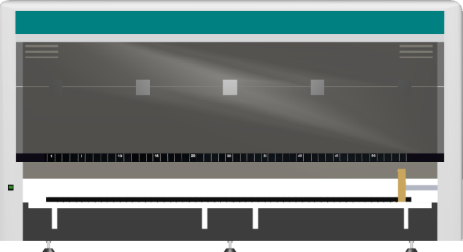
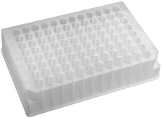
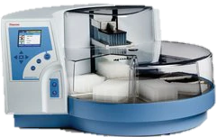
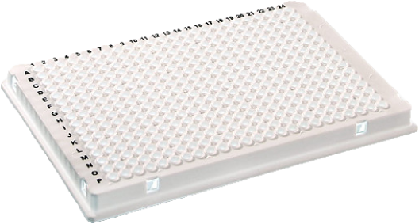
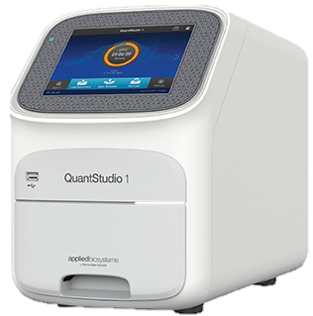
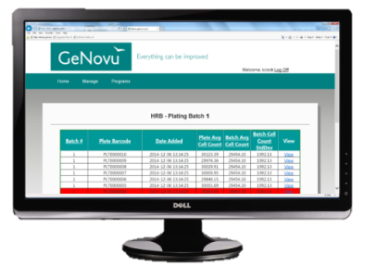
Workflow
1. Screening Pooling Prep
2. Sample Extraction
3. RT-PCR Prep
GeNovu Database
6. Sample Confirmatory Prep
4. RT-PCR
Data
Transfer
Sample
Transfer
5. Data Analysis

